Slide 1

Order Management System
Saraunsh S Jadhav
16010120126 - B3
Jheel K Gala
16010120132 - B3
Mini Project

Slide 2
~Problem Definition~
The aim of the project is to facilitate the users to keep a track of their clients and customers, their products and their orders
This project is Order Management System; the main aim of this project is to provide service to the companies and customers. The system can serve the customer needs like Company Details, Product details and Order Details which include the exact specific details of the order placed, devices bought, status of the order, rate of each item and the total amount to be paid.
The system is intended to support day-to-day operations of Companies by improving various processes of Inventory Details, Placing Orders and providing service to the customers with minimum amount of errors.

Slide 3
Software & Hardware requirements
Software Requirements:
Operating System : Windows 7 and above
Front end: Python
Hardware Requirements:
PROCESSOR: Core i3 or above
RAM: 1 GB
HARD DISK: 160 GB Network Interface.

Slide 4
Features
The Menu Screen comprises of:
Customer: Customer ID is a unique number or combination of numbers assigned to a customer.
Customer Name displaying the name of the customer.
GST Number consists of 15 characters.
And some other customer details like Phone No., Email ID & Address which are required for placing an order.
Product: Product ID is a unique number or combination of numbers assigned to a product.
Product Name displaying the name of the product and each product’s rate.
ORDER: Consisting of Order Master and Order Details
Order Master includes Order ID, date of the order placed, customer name, status of the order( Pending, Delivered or Cancelled ) and the total amount.
Order Details include the serial number and ID of the order, name and quantity of the product ordered, rate of each product and the Total Amount to be paid.
Exit

Slide 5
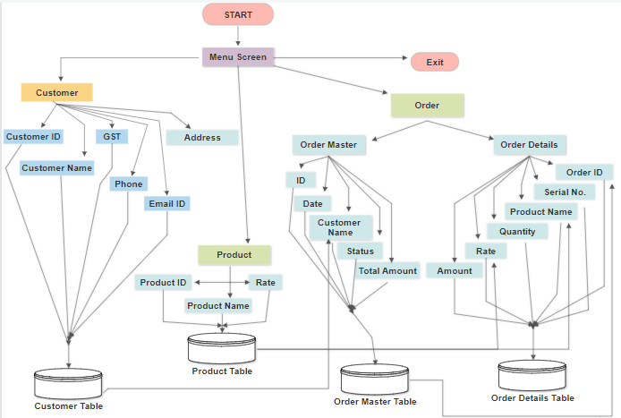
Flowchart

Slide 6

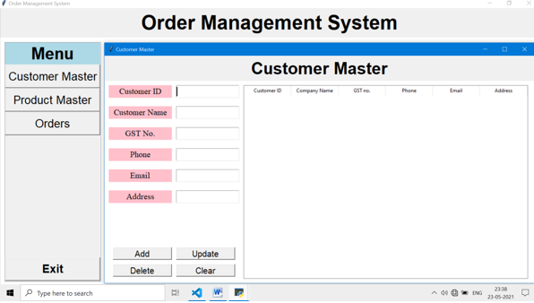
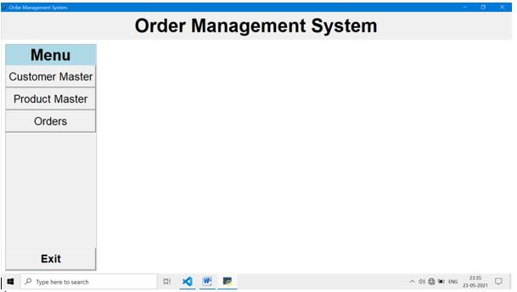
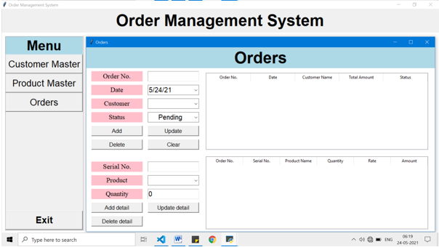
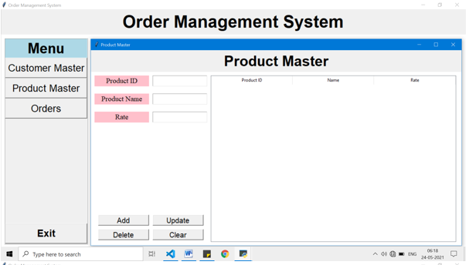
Screenshots

Slide 7
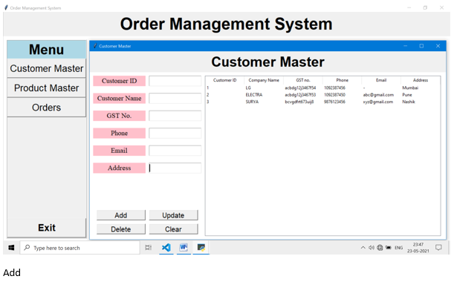
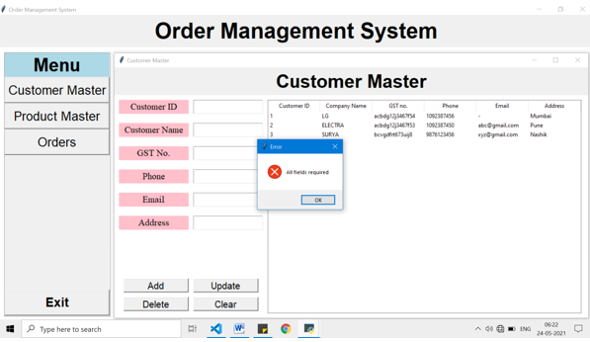
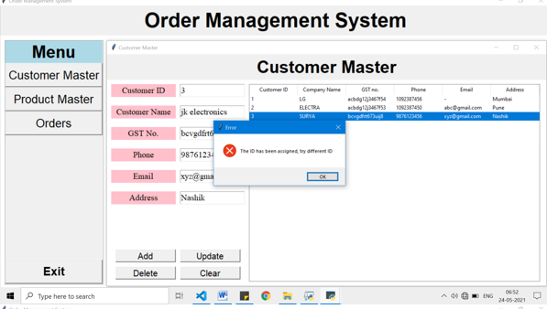
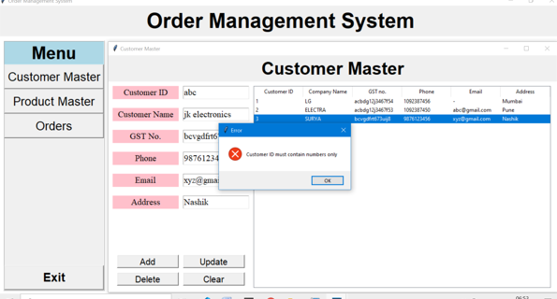

Slide 8
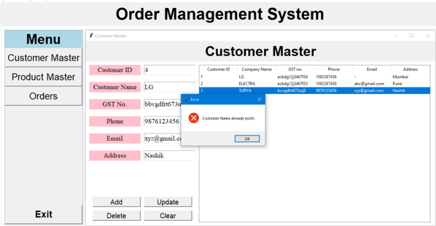
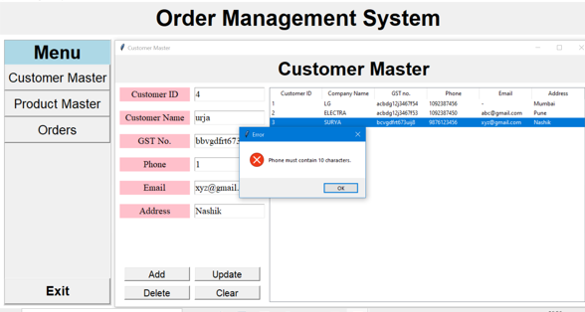
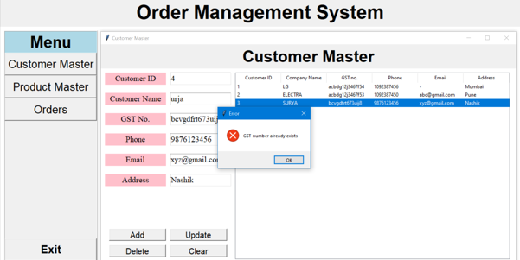
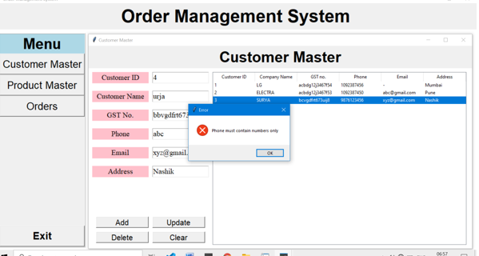

Slide 9
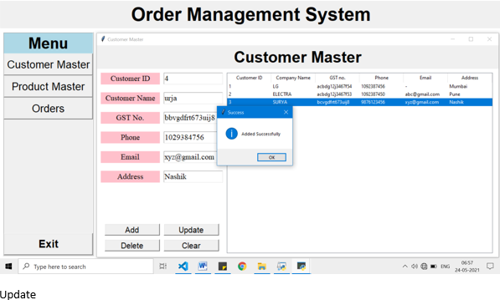
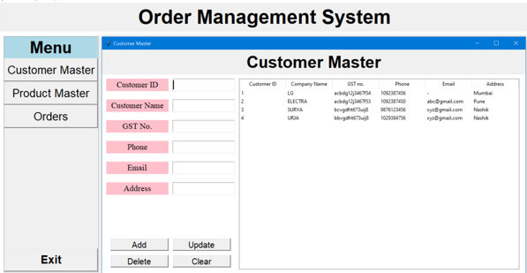
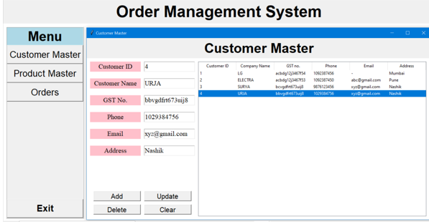
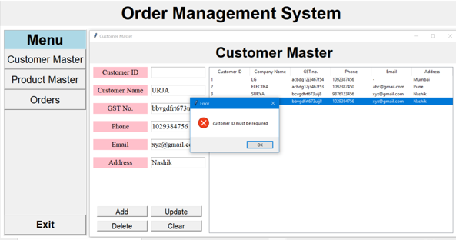

Slide 10
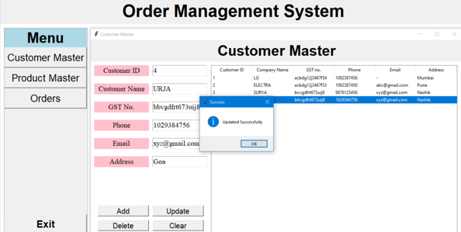
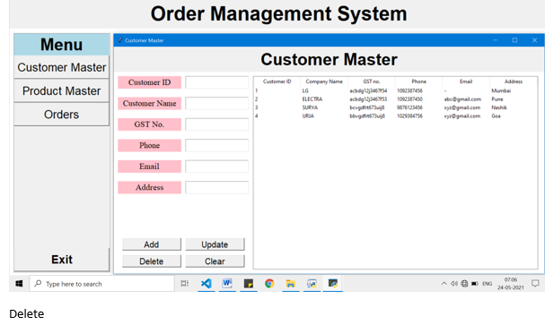
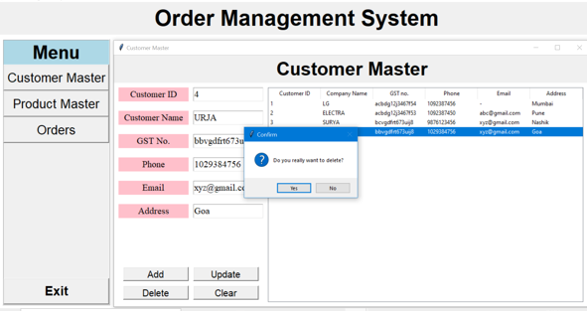
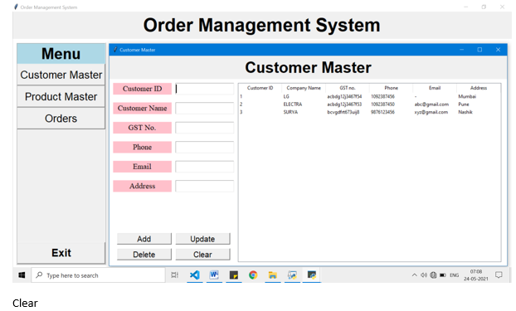

Slide 11
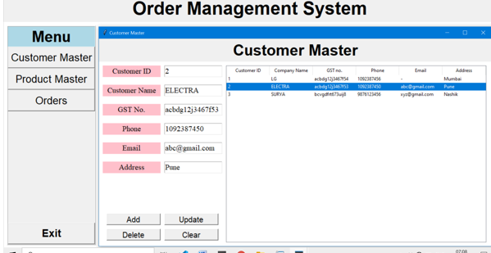
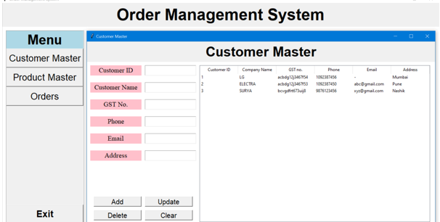
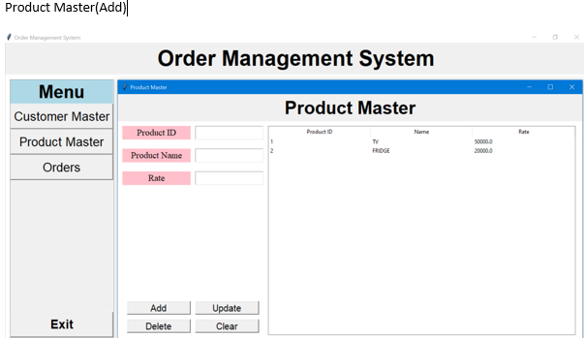
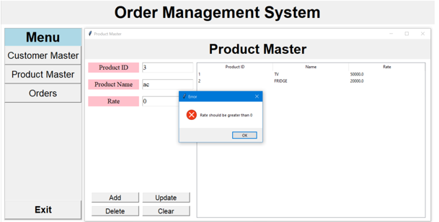

Slide 12
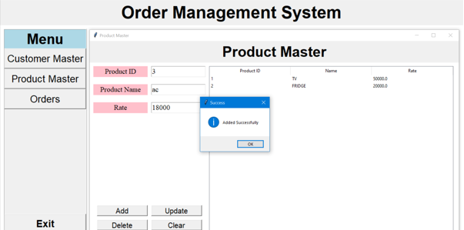
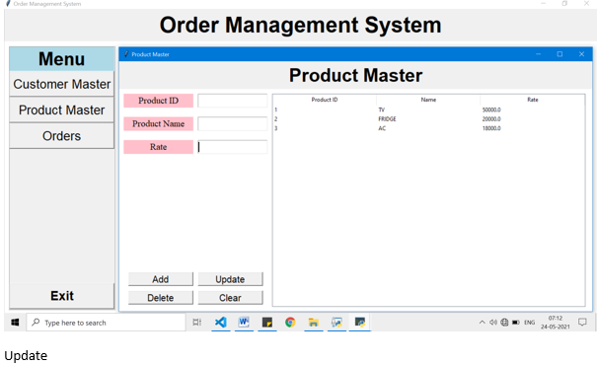
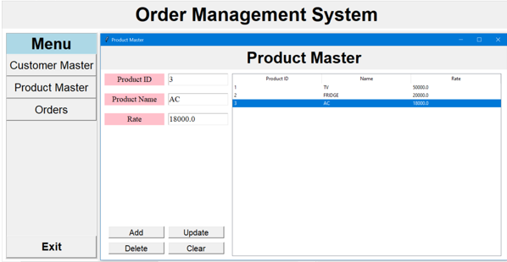
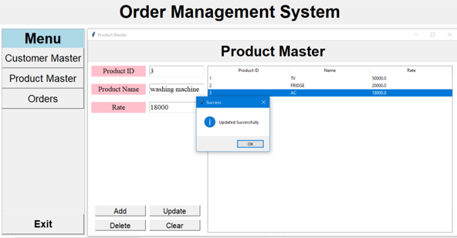

Slide 13
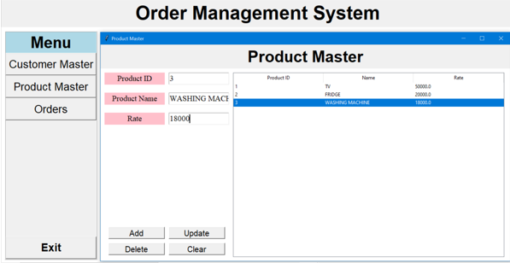
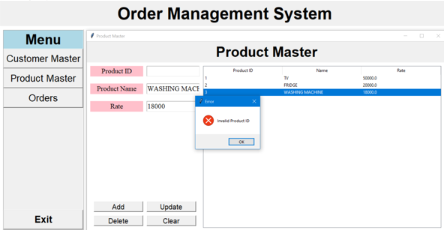
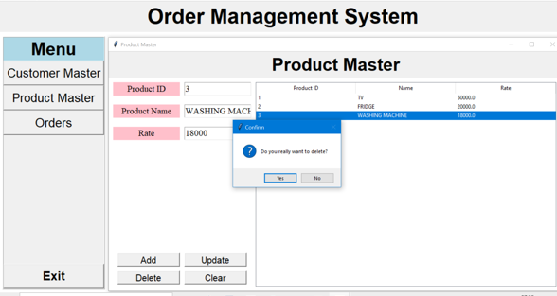
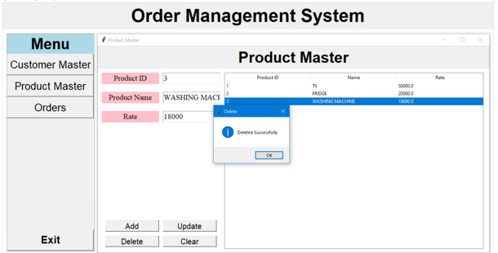

Slide 14
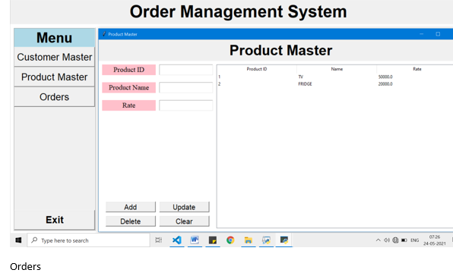
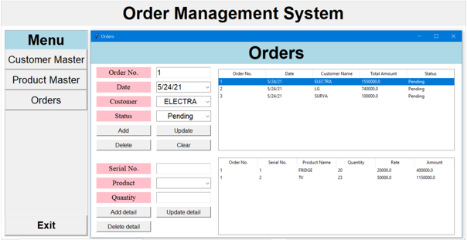
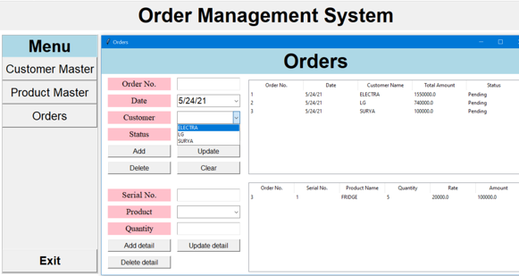
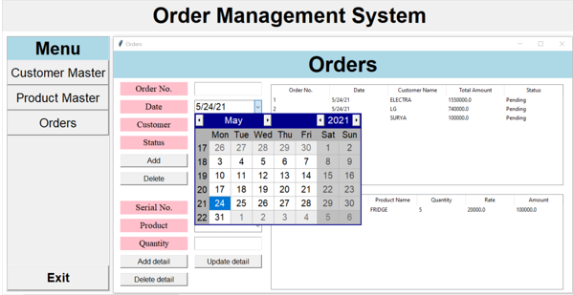

Slide 15
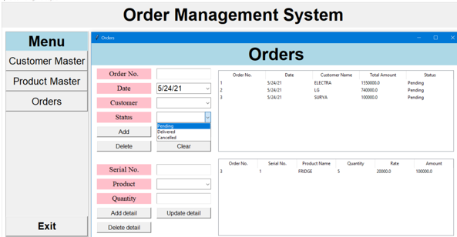
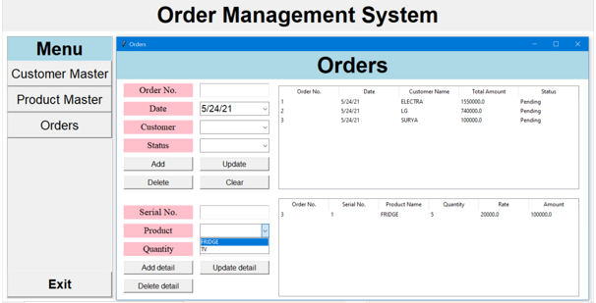
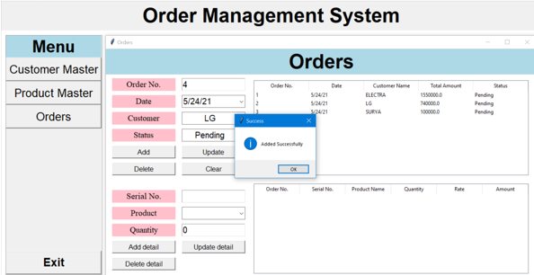
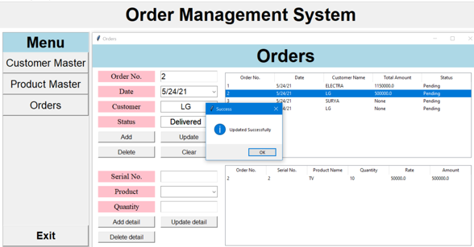

Slide 16
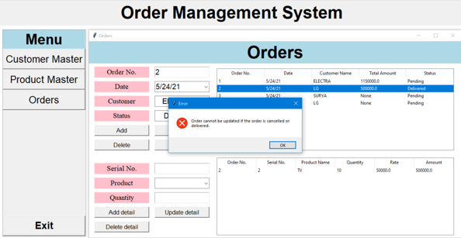
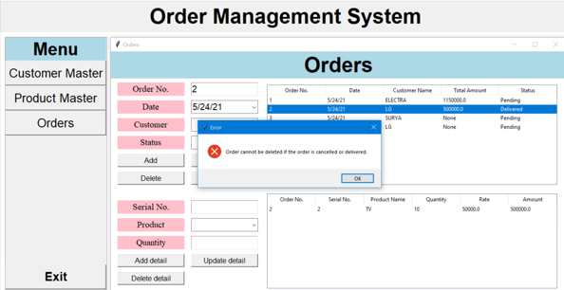
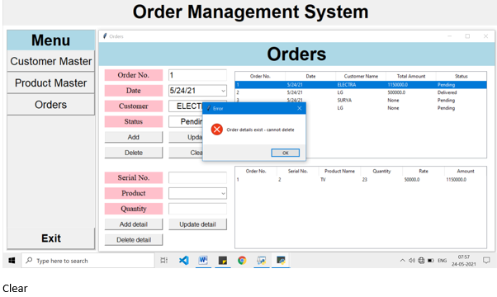
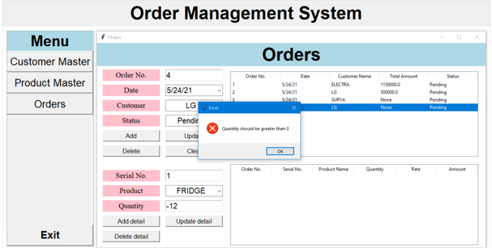

Slide 17
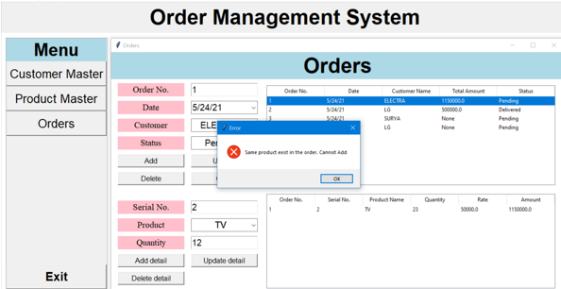
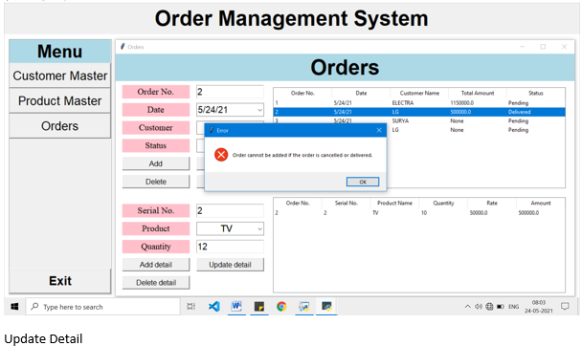
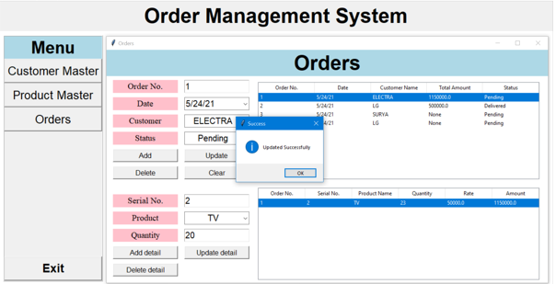
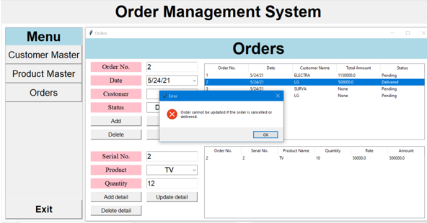

Slide 18
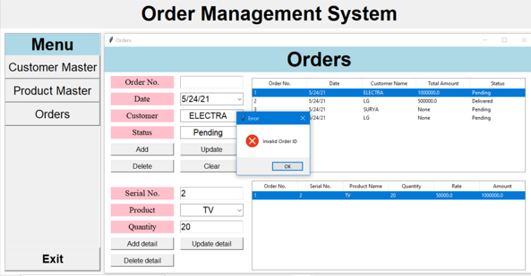




Slide 19





Slide 20
Teamwork
Packages
Screen Design: Saraunsh and Jheel.
Db Designing and Project Functionality: Jheel
PPT: Saraunsh
Tkinter
SQ Lite 3
Tkcalendar
SCOPE: based on CRUD system
Difficulties Faced
Designing the screens in Tkinter by becoming familiar with the widgets.
Connecting the data to sqllite 3 so that the data can be saved.
Github
https://github.com/jheel0802/Order-Management-System.git

Slide 21
~Thank You~

